Slide 1


CAB OPERATION ANALYSIS REPORT
USING MYSQL AND POWER BI

Slide 2
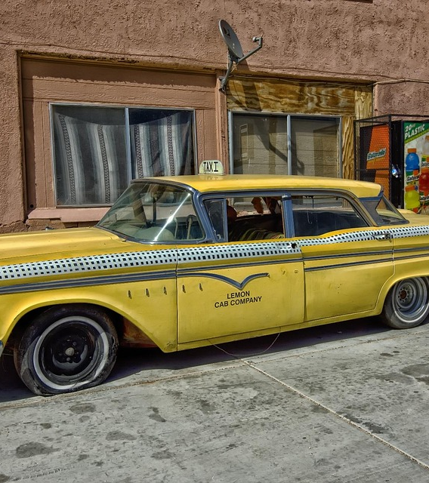

📊 𝗣𝗿𝗼𝗷𝗲𝗰𝘁 𝗢𝘃𝗲𝗿𝘃𝗶𝗲𝘄:
• 𝗚𝗼𝗼𝗱𝗰𝗮𝗯𝘀 is a two-year-old cab service company thriving in tier-2 cities across India. • Operating in 10 cities, it focuses on supporting local drivers, delivering excellent passenger experiences, and fostering sustainable growth.

Slide 3

🚩 𝐏𝐫𝐨𝐛𝐥𝐞𝐦 𝐒𝐭𝐚𝐭𝐞𝐦𝐞𝐧𝐭 • To achieve its ambitious 2024 performance targets, GoodCabs tasked the data analytics team with assessing: ➡️ Trip volume ➡️ Repeat passenger rate ➡️ Passenger satisfaction ➡️ Balance between new and repeat passengers.
🎯 𝐏𝐫𝐨𝐣𝐞𝐜𝐭 𝐎𝐛𝐣𝐞𝐜𝐭𝐢𝐯𝐞: • Analyze dataset to address key Business Questions on City - Level Trip Performance, Passenger Trends, Revenue Patterns, and Target Achievement. • Present findings in a clear and visually engaging manner to assist the Chief of Operations in making informed strategic decisions.

Slide 4

🎯 Objective Analyze dataset to address key Business Questions on City - Level Trip Performance, Passenger Trends, Revenue Patterns, and Target Achievement. Present findings in a clear and visually engaging manner to assist the Chief of Operations in making informed strategic decisions.
⚒️ 𝗧𝗼𝗼𝗹𝘀 𝗨𝘀𝗲𝗱:
Data Visualization: Power BI
Data Analysis: SQL
Data Modeling: Snowflake schema
Tools: Excel, SQL, Power BI Desktop, Power BI Service and Powerpoint.

Slide 5
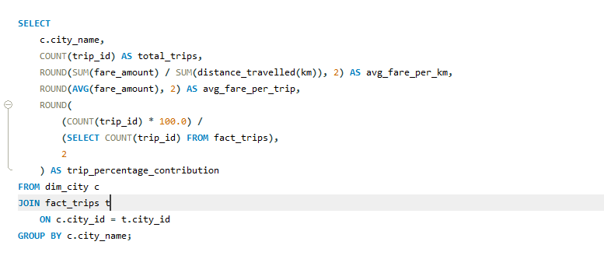
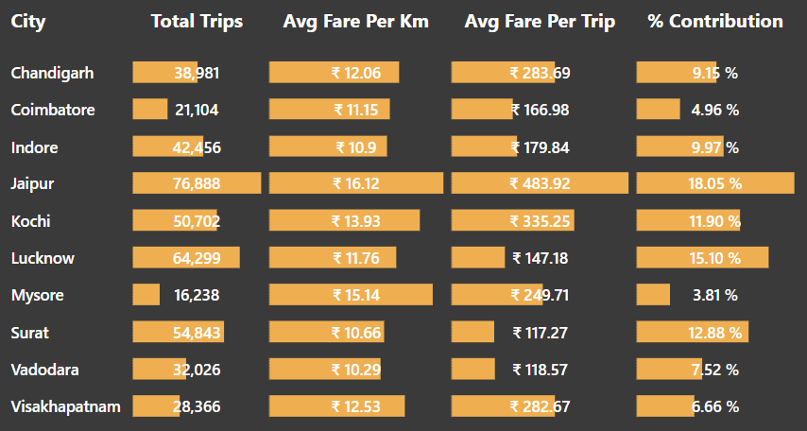
# BUSINESS REQUEST _1 :- CITY-LEVEL FARE AND TRIP SUMMARY REPORT * GENERATE A REPORT THAT DISPLAY THE TOTAL TRIPS, AVERAGE FARE PER KM, AVERAGE FARE PER TRIP, AND THE PERCENTAGE CONTRIBUTION OF EACH CITY'S TRIPS TO THE OVERALL TRIPS. THIS REPRT WILL HELP IN ASSESSING TRIP VOLUME, PRICING EFFICIENCY, AND EACH CITY'S CONTRIBUTION TO THE OVERALL TRIPS COUNT. -- * CITY_NAME-- * TOTAL_TRIPS-- * AVG_FARE_PER_TRIP

Slide 6
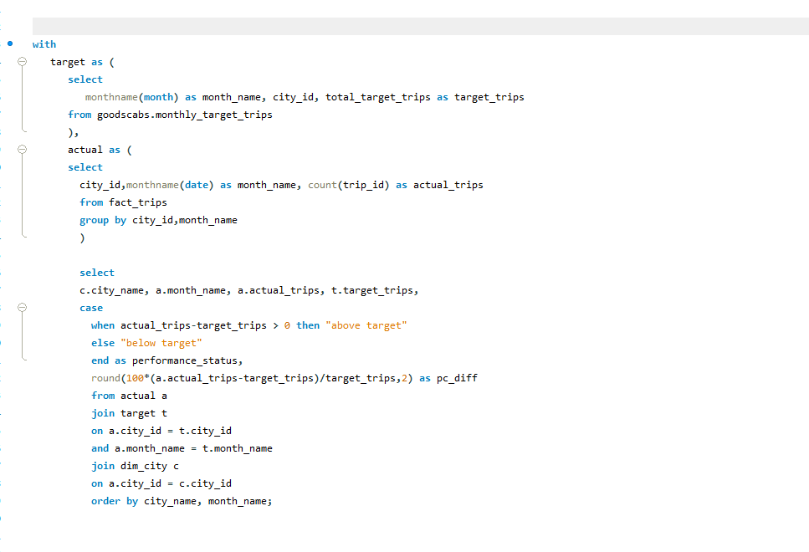
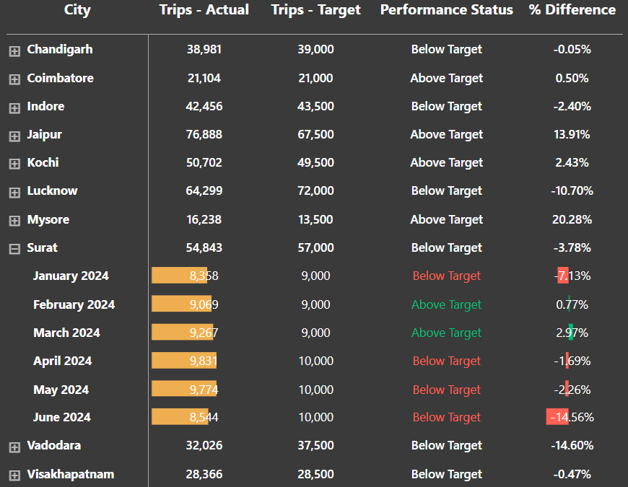
# BUSINESS REQUEST:- GENERATE A REPORT THAT EVALUTES THE TARGET PEFORMANCE FOR TRIPS AT THE MONTHLY AND CITY LEVEL FOR EACH CITY AND MONTH COMPARE THE ACTUAL TOTAL TRIPS WITH THE TARGET TRIPS AND CATEGORIES THE PERFORMANCE AS FOLLOWS :-- 1, IF ACTUAL TRIPS ARE GREATER THAN TARGET TRIPS, MARK IT AS 'ABOVE TARGET’. 2, IF ACTUAL TRIPS ARE LESS THAN OR EQUAL TO TARGET TRIPS, MARK IT AS 'BELOW TARGET'. -- ADITIONALLY ,CALCULATE THE % DIFFERENCE BETWEEN ACTUAL AND TARGET TRIPS TO QUANTIFY THE PERFORMANCE GAP.– FIELDS;-- 1.CITY_NAME, 2.MONTH_NAME, 3.ACTUAL_TRIPS, 4.TARGET_TRIPS, 5.PERFORMANCE_STATUS, 6.%_DIFFERENCE

Slide 7
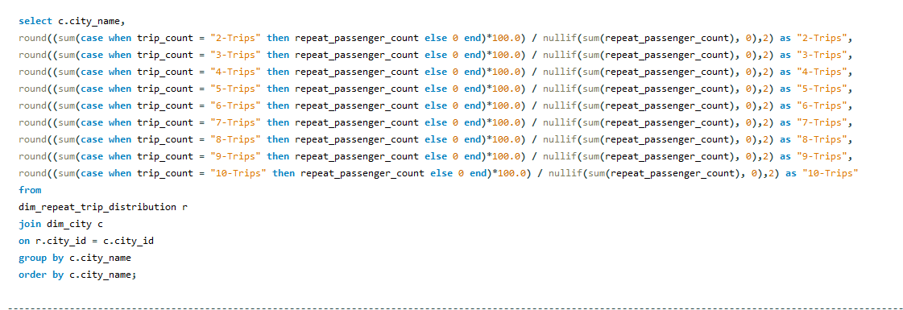
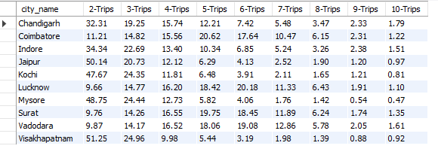
# bussiness request - 3 :- city-level repeat passenger trip frequency report:- Generate a report that show the percentage distribution of repeat passengers by the number of trips they taken in each city. calculate the percentage of repeat passengers who took 2 trips , 3 trips, and so on ,up to 10 trips. each column should represent a trip count category, displaying the percentage of repeat passengers who fall into that category out of the total repeat passengers for that city . this report will help identifying cities with high repeat trips frequency, which can indicate strong customer loyalty or frequency usage patterns.

Slide 8
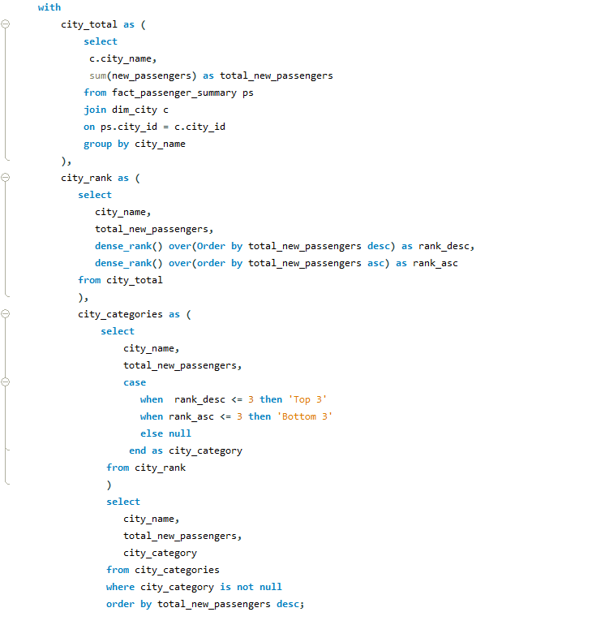
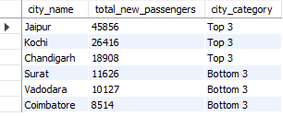
business request - 4 :- identify cities with highest and lowest total new passengers :- Generate a report that calculates the total new passengers for each city and ranks them based on this value. identify the top 3 cities with the highest number of new passengers as well as the bottom 3 cities with the lowest number of new passengers, categorising them as 'Top 3' or 'Bottom 3' accordingly.

Slide 9
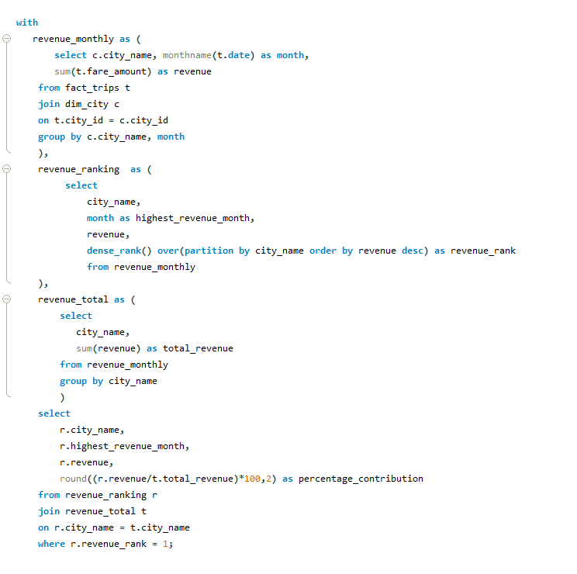
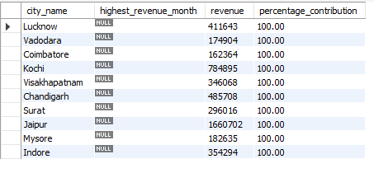
# business request - 5 :- identify month with highest revenue for each city Generate a report that identifies the month with the highest revenue for each city. for each city, display the month name , the revenue amount for that month, and the percentage contribution of that month's revenue to the city's total revenue.

Slide 10
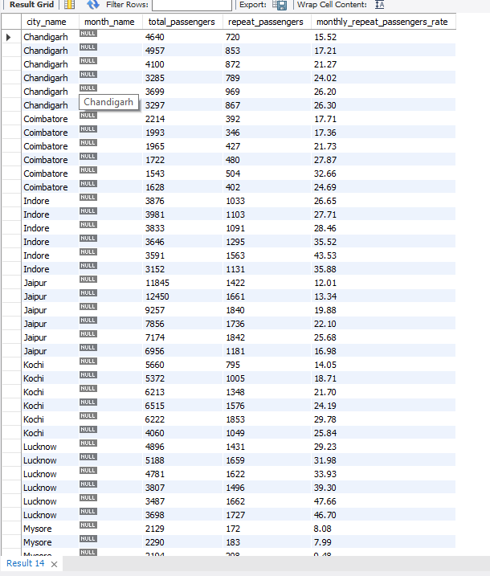
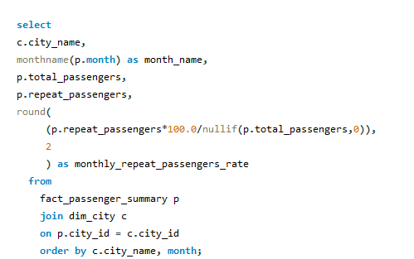
# business request -6: repeat passenger rate analysis:- generate a report that calculate two metrics : 1.monthly report passenger rate: calculate the repeat passenger rate for each city and monthly by comparing the number of repeated passengers to the total passengers . these metrics will provide insights into monthly trends as well as the overall repeats behaviour for each city.

Slide 11
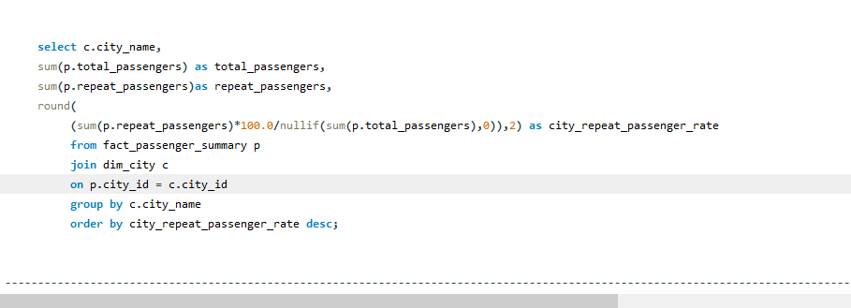
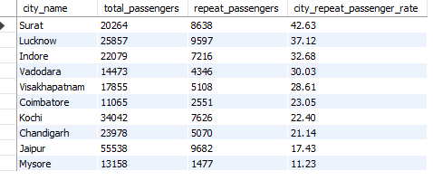
# business request 7 : repeat passengers rate analysis:- city wide repeat passenger rate: calculted the overall repeat passenger rate for each city, considering all passengers rate for each city, considering all passengers across months. these metrics will provide insights into monthly repeat trends as well as the overall repeats behaviour for each city

Slide 12
💡 Key Insights Jaipur: Contributes the highest to Trips (18%) and Revenue (₹37.2M, 34%) but relies heavily on New Passengers (80%). Lucknow: Ranks second in Trips (15%) but has low Revenue due to poor Ratings and lower Average Fare Per Trip. Mysore: Small contributor (4% of Trips) but exceeds Trip Targets by 20%, demonstrating high efficiency and satisfaction (Ratings above 8.0). Surat: Leads in Repeat Passenger Rate (42%) but struggles with Low Ratings due to lower fares. Seasonal Trends: Trips peaked in February and March, declining steadily afterwards, but Repeat Passenger loyalty increased during off-peak months.

